Slide 1
FACULTY PHONE NUMBER MANAGEMENT

Slide 2
PROJECT MEMBER’S DETAILS
COLEGE NAME : Pragati Engineering College (Autonomous)
BRANCH : CIVIL
TEAM MEMBERS:
1) Team Leader: A. Veerendra
2) A.Jyothsna Priyanka
3) B.Joshna
4) G.Akash

Slide 3
INTRODUCTION
The Faculty Phone Number Management System is a simple and efficient software designed to store, access, update, search, and delete faculty contact information. This system uses C programming concepts such as structures, file handling, and menu-driven logic. It is highly useful for academic mini projects

Slide 4
REQUIREMENTS
Hardware Requirements : Any PC or Laptop with a minimum of 512 MB
RAM20 MB free storage
Software Requirements : C Compiler (Turbo C / Code::Blocks / GCC)Operating System: Windows/Linux
Required C-programming concepts : structures , file handling functions , pointers , dynamic memory allocation(malloc , calloc ) , functions , string manipulation ,etc.)
Knowledge Required : Basics of C programming File handling in C Structures and arrays

Slide 5
ALGORITHM
Step 1: Start the program.
Step 2: Display menu options:
1. Add faculty
2. View faculty
3. Search faculty
4. Update faculty
5. Delete faculty
6. Exit Step
Step 3 : Get the user choice.
Step 4: Perform the action based on user choice:
Add: Ask for name, department, phone number, then save to file
.View: Read all records from file and display them.
Search: Ask for name, then check each record. Display if found.
Update: Ask for name, then update the phone number if record exists.
Delete: Ask for name, remove the record from file.
Step 5: Loop back to menu until user selects Exit.
Step 6: End program.

Slide 6
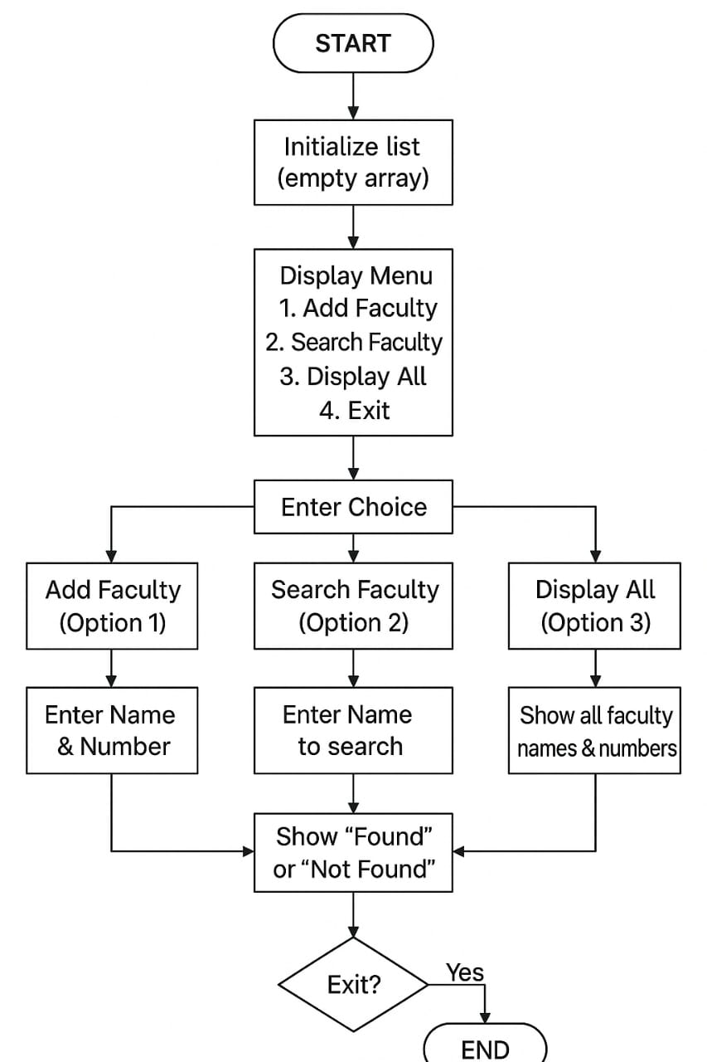
FLOWCHART

Slide 7
MODULE DESCRIPTION
MODULE 1: ADD FACULTY
• Allows user to input name, department, and phone number.
• Stores the data permanently using file handling.
MODULE 2: VIEW FACULTY LIST
• Displays all stored faculty records.
• Reads data from file and prints in tabular format.
MODULE 3: SEARCH FACULTY
• Searches for a faculty using name.
• Displays complete details if found.
MODULE 4: UPDATE FACULTY
• Updates department or phone number of an existing faculty.
• Uses temporary file method for replacement.
MODULE 5: DELETE FACULTY
• Removes a faculty record from the list.
• Rewrites file without the selected entry.
MODULE 6: EXIT SYSTEM
• Safely terminates the application.

Slide 8
MODULE INTEGRATION
1. User Authentication Module → Faculty Module
The system first verifies the user (admin/management).
After login, access is granted to the Faculty Management Module.
Only authenticated users can add, edit, or view faculty data.
Integration Flow:
Login → Validate → Redirect to Faculty Dashboard
2. Faculty Management Module → Subject/Department Module
While adding a new faculty member, the admin must assign:
  Department
  Subjects handled
These details come from the Department & Subject Module.
Integration Flow:
Faculty Module ↔ Subject & Department Module
3. Department Module → Timetable/Workload Module
Each department’s faculty are mapped to their:
  Class timings
  Subjects
  Workload hours
These details help the system generate or view faculty workload.
Integration Flow:
Department → Workload/Time
4. Attendance Module → Workload Module
Faculty attendance data is used to track:
  Working hours
  Leave taken
  Replacement/adjustment details
This supports calculating the total workload.
Integration Flow:
Attendance → Workload
able Module

Slide 9
5. Faculty Module → Payroll/Report Module
Faculty details (experience, attendance, workload) are used to generate:
  Monthly reports
  Salary calculations (if included)
  Department summaries
Integration Flow:
Faculty + Attendance + Workload → Reports
6. Database Module → All Modules
The database acts as the central integrator.
All modules read/write to the same database tables:
  Faculty data
  Department/Subject data
  Attendance records
  Workload reports
LOGIC :
input ID
search faculty
IF found:
shift array elements left
count--
ELSE:
print "Not Found"

Slide 10
COMPLETE CODE
#include <stdio.h>
#include <string.h>
struct Faculty {
char name[50];
char phone[15];
};
int main() {
struct Faculty list[50];
int count = 0, choice;
char searchName[50];
while (1) {
printf("\n--- Faculty Phone Manager ---\n");
printf("1. Add Faculty\n");
printf("2. Search Faculty\n");
printf("3. Display All\n");
printf("4. Exit\n");
printf("Choice: ");
scanf("%d", &choice);

Slide 11
COMPLETE CODE
if (choice == 1) {
printf("Name: ");
scanf("%s", list[count].name);
printf("Phone: ");
scanf("%s", list[count].phone);
count++;
printf("Added Successfully!\n");
}
else if (choice == 2) {
printf("Enter name: ");
scanf("%s", searchName);
int found = 0;
for (int i = 0; i < count; i++) {
if (strcmp(list[i].name, searchName) == 0) {
printf("Phone Number: %s\n", list[i].phone);
found = 1;
break;
}
}
if (!found) printf("Faculty Not Found!\n");
}

Slide 12
COMPLETE CODE
else if (choice == 3) {
printf("\n--- Faculty List ---\n");
for (int i = 0; i < count; i++)
printf("%s - %s\n", list[i].name, list[i].phone);
}
else if (choice == 4) {
printf("Thank You!\n");
break;
}
else {
printf("Invalid Choice!\n");
}
}
return 0;
}

Slide 13
OUTPUT
Sample Output
1) Adding Faculty
Enter your choice: 1
Enter Faculty Name: SaiKumar
Enter Department: CSE
Enter Phone Number: 9876543210
Faculty Added Successfully!
2) Viewing Faculty List
Enter your choice: 2
----- Faculty List -----
Name: SaiKumar | Dept: CSE | Phone: 9876543210
3) Searching Faculty
Enter your choice: 3
Enter name to search: SaiKumar
Record Found:
Name: SaiKumar | Dept: CSE | Phone: 9876543210
4) Updating Faculty
Enter your choice: 4
Enter name to update: SaiKumar
Enter New Department: AIML
Enter New Phone Number: 9900012345
Record Updated Successfully!
5) Deleting Faculty
Enter your choice: 5
Enter name to delete: SaiKumar
Record Deleted Successfully!
6) Exiting Program
Enter your choice : 6
Thank you ! Exiting Program

Slide 14
CONCLUSION
The Faculty Phone Number Management System is a simple yet effective program that helps manage faculty details efficiently. Using C programming, structures, and file handling, the system allows users to add, view, search, update, and delete faculty records easily. It provides a digital alternative to manual record keeping, reducing errors and saving time.

